Slide 1
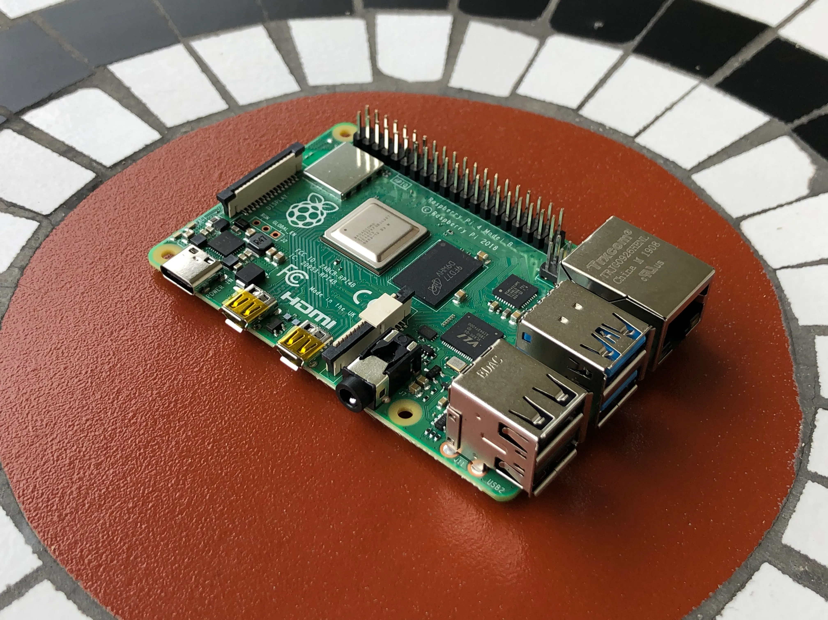
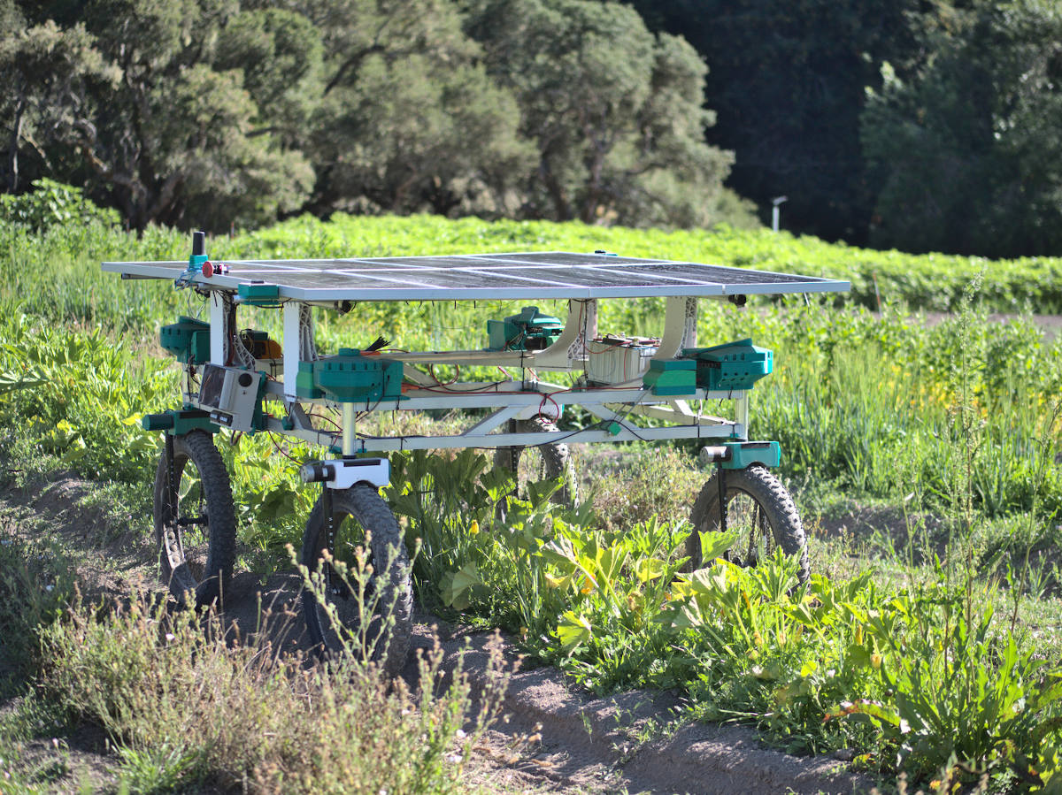
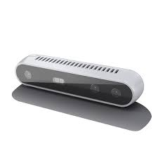
Autonomous Field Rover Robot that autonomously creates a 3D map of a given field.
Rover: A programed robot suitable for field conditions. Comes equipped with a lightweight chassis, drive motors, 3 Intel D415 depth cameras, and a Raspberry Pi 4 model B.
Programming: Equipped with algorithms, using Python - OpenCV, for path finding to ensure the robot travels down each crop row without missing or overlapping mapped area. Utilizes image stitching to produce a 3D map of the field.
User Interface: Connect with the Raspberry Pi OS – Command Line Interface for users to view the rover’s most up-to-date data. Command the rover through the CLI with a set of given options.
Adaptability: Equip the robot with additional sensors to gather more information about the environment.
Raspberry Pi 4 model B – Main Control Unit
Intel D415 Depth Camera – 3 Attached to Rover
Twisted Fields Rover - Inspiration
Austyn Smock: arsmock1@buffs.wtamu.edu Nathan Lancaster: nmlancaster1@buffs.wtamu.edu Aidan Pantoya: adpantoya1@buffs.wtamu.edu

